Slide 1
Lifestyle Store Detailed Developer Report

Slide 2
INTRODUCTION :
This is the vulnerability project and penetration testing ( VAPT ) report for “Lifestyle Store”.
All vulnerabilities found on this store with their screenshots and links are reported.
I have also provided business risks and expert recommendations to tackle those vulnerabilities.

Slide 3
SECURITY STATUS: Extremely Vulnerable
SQLi: Hackers can steal all records from the databases of the website. Hackers can take complete control of the website including view, edit, add or delete files and folders via shell upload.
IDOR: Hackers can extract mobile numbers of all customers using user-id. Hackers can change the source code and can upload any malicious code, phishing etc. in the website via shell upload.
XSS: Hackers can trick users to click on malicious pop up links and steal information via cross-site-scripting.

Slide 4
VULNERABILITY STATISTICS:
Critical | Severe | Moderate | Low
12 | 7 | 3 | 3

Slide 5
VULNERABILITIES FOUND:
S NO. | CONDITION | VULNERABILITY | COUNT
1. | CRITICAL | SQL INJECTION | 2
2. | SEVERE | STORED AND REFLECTED XSS | 3
3. | CRITICAL | IDOR | 4
4. | SEVERE | RATE LIMITING FLAW | 2
5. | CRITICAL | INSECURE FILE UPLOAD | 2
6. | MODERATE | CLIENT SIDE FILTER BYPASS | 2
7. | SEVERE | SERVER MISCONFIGURATION | 2
8. | CRITICAL | PII LEAKAGE | 4
9. | CRITICAL | OPEN REDIRECTION | 4

Slide 6
1. SQL INJECTION (CRITICAL)

Slide 7
Below mentioned URL is vulnerable to SQL injection attack.
Relevant URL:
http://13.127.120.228/products.php?cat=1
Affected Parameters:
category (GET)
Payload:
cat=1’

Slide 8
Other similar URLs vulnerable to SQLi:
URL #1:
http://13.127.120.228/products.php?cat=2
URL #2:
http://13.127.120.228/products.php?cat=3
PAYLOAD:
cat=1’

Slide 9
Observations: Following slides have details about the vulnerability observed.

Slide 10
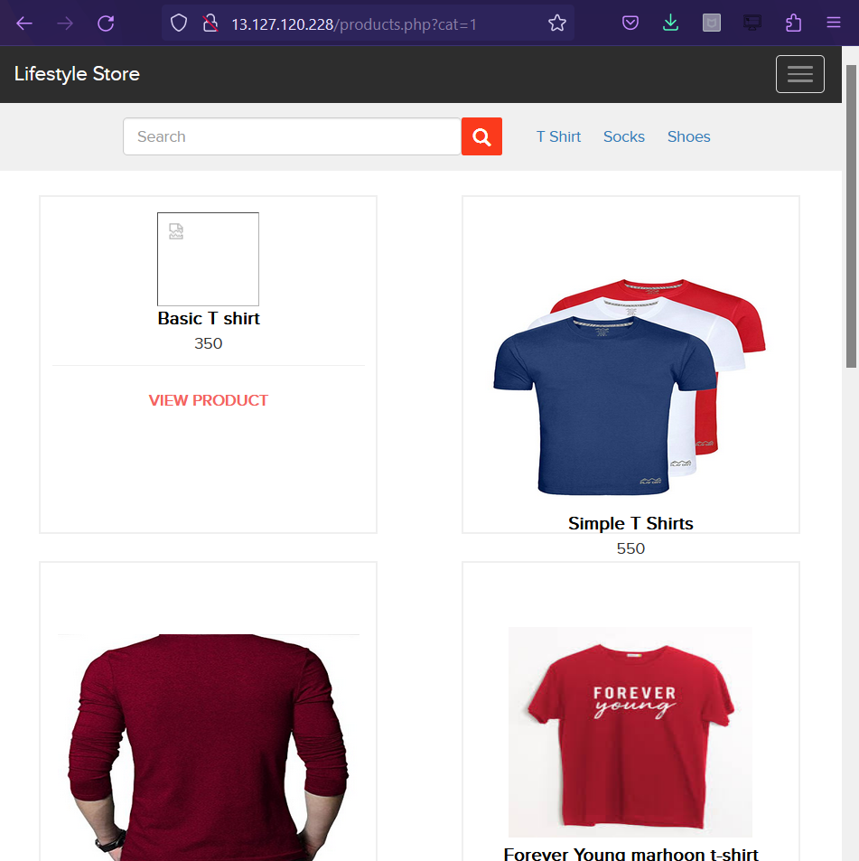
Go to the categories option from the homepage of the e-commerce website and click on “T-Shirt”, “Socks” or “Shoes” to get into the URL, you will see products as per the option you have chosen but notice the get parameter in the URL.

Slide 11
When you add a single quote ‘ in the get parameter, you get a MySQL error.

Slide 12

Recheck, you can put “--+” in the end of the parameter, and the page loads in its original format, this confirms the error.

Slide 13
Proof of concept: Following slides have the proof and risks of the proposed vulnerability.

Slide 14
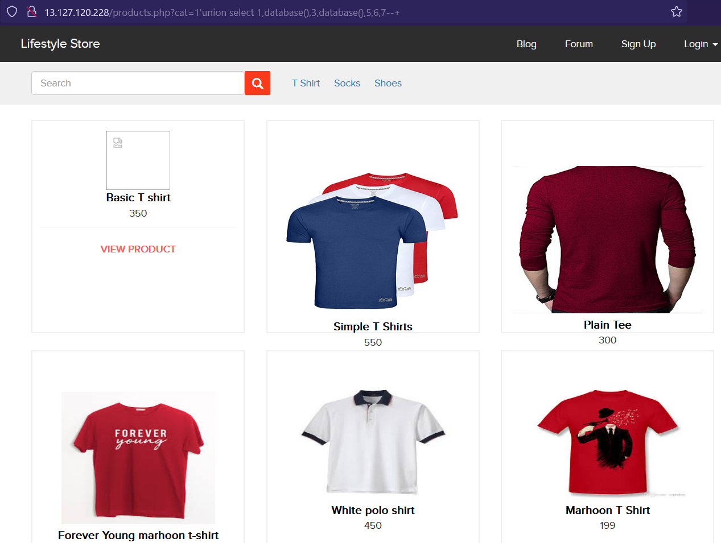
Hacker can execute commands as shown below to get critical information, here we have used the payload to find the name of the database of MySQL.

Slide 15
Proof of concept:
No. of Databases: 2
Information_Schema
Hacking_training_project
No. of tables in “Hacking_training_project”: 10
order_items
brands
cart_items
categories
customers
orders
product_reviews
products
users
sellers

Slide 16
Business Impact: The impact on the company if the vulnerability is exploited.

Slide 17
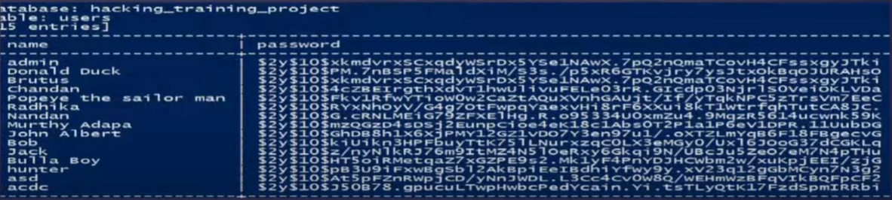
Business Impact:
Using this vulnerability, the attacker can execute arbitrary SQL commands on Lifestyle Store’s server and gain complete access to the internal database, which also makes all customer data inside it visible.
Below is the screenshot of users table which shows user credentials being leaked.
The data above can be decoded using Burp Suite, the attacker can decode and use this information to login to admin panel and gain complete admin level access to the website which could lead to complete compromise of the server and all other servers connected to it

Slide 18
Recommendations: Take the following recommendations to secure and avoid SQL database exploitation.

Slide 19
Recommendations:
Prepared statements: Use SQL prepared statements available in all web development languages and frameworks to avoid attacker being able to modify SQL query.
Do not run Database service as admin/root user.
Disable default accounts, passwords and databases.
Assign each Database user only the required permissions and not all permissions.
Character encoding: Convert simple codes into different characters like ‘~’/”^’. It is also suggested to follow HTML and other encodings.

Slide 20
References:
https://owasp.org/www-community/attacks/SQL_Injection
https://en.wikipedia.org/wiki/SQL_injection

Slide 21
2. ACCOUNT TAKEOVER VIA OTP BYPASS (CRITICAL)

Slide 22
Below mentioned page has a login form that follows login via OTP that can be brute forced.
RELEVANT URL:
http://13.127.120.228/login/admin.php
AFFECTED PARAMETERS:
OTP (POST)

Slide 23
Observations: Following slides have the details about the vulnerability observed.

Slide 24
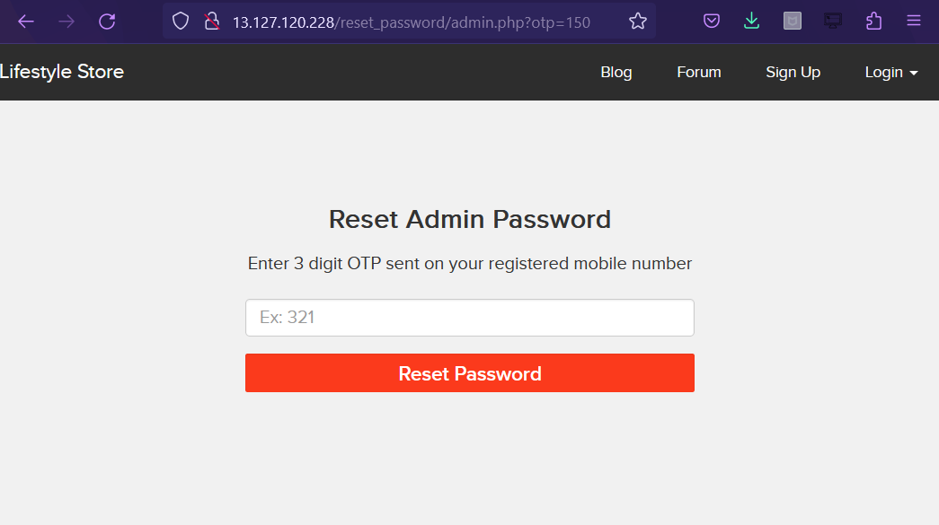
Navigate to http://13.127.120.228/login/admin.php you will see a “forgot your password” hyperlink which asks for OTP which is sent to victim’s mobile number, input any anonymous 3 digit OTP and intercept the request with burp suite.

Slide 25
Proof of concept: Following slides have the proof and risks of the proposed vulnerability.

Slide 26
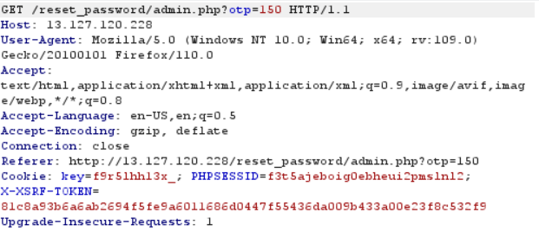
The request below will be generated in burp suite using GET parameter.

Slide 27
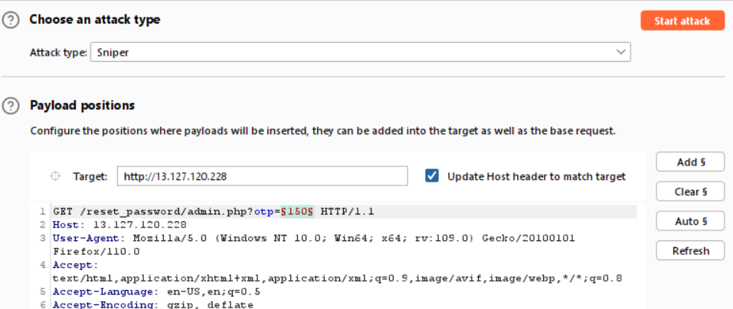
We will brute force by getting all combinations of 3 digit OTPs and input the correct one to bypass.

Slide 28
Business impact: The impact on the company if the vulnerability is exploited.

Slide 29
Business Impact:
A malicious hacker can gain complete access to admin account just by brute-forcing due to rate limiting flaw as a hacker can attempt as many times as he wants as there is no bounds in number of trials.
This leads to complete compromise of personal user data of every customer.
Attacker can login, then carry out actions on behalf of the victim which could lead to serious financial loss.

Slide 30
Recommendations: Take the following recommendations to secure and avoid OTP bypass.

Slide 31
Recommendations:
Use rate limiting checks on the number of times the OTP request is generated.
OTP should be at least of 6 digits, a 3 digit OTP can be guessed or brute-forced easily.
OTP should expire in a particular time like 2 to 5 minutes to make authorization process more secure.

Slide 32
References:
https://owasp.org/www-project-mobile-app-security/

Slide 33
3. UNAUTHORIZED ACCESS TO CUSTOMER DETAILS (CRITICAL)

Slide 34
The “My orders” section of the website shows am Insecure Direct Object Reference (IDOR), this allows hackers to get access to any customer’s order details and more.
RELEVANT URL:
http://13.127.120.228/orders/orders.php?customer=18
AFFECTED PARAMETERS:
Customer data (GET)

Slide 35
Other URL with similar issues
RELEVANT URL:
http://13.127.120.228/products/details.php?p_id=5
AFFECTED PARAMETRS:
P_ID (GET)

Slide 36
Observations: Following slides have the details about the vulnerability observed.

Slide 37
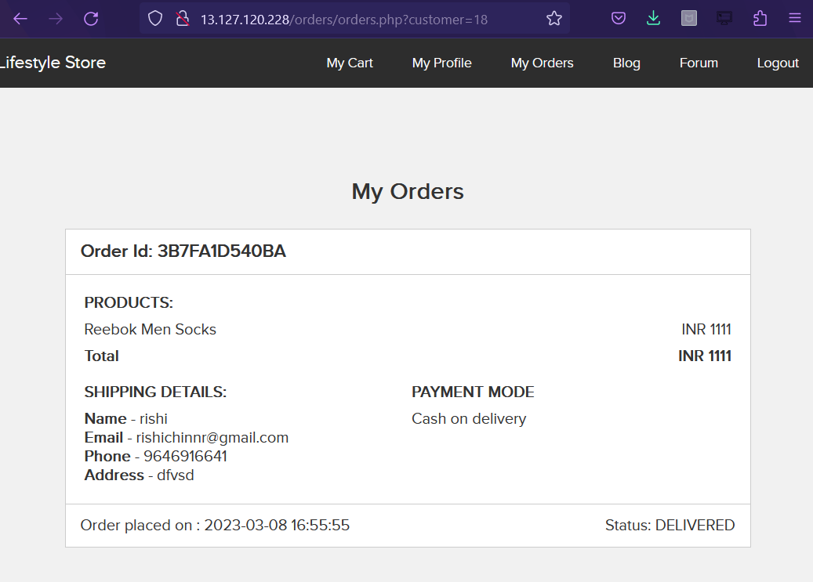
Login to your account and go to “My orders” section, you will see a GET parameter as shown below “customer=18”

Slide 38
Proof of concept: Following slides have the proof and risks of the proposed vulnerability.

Slide 39
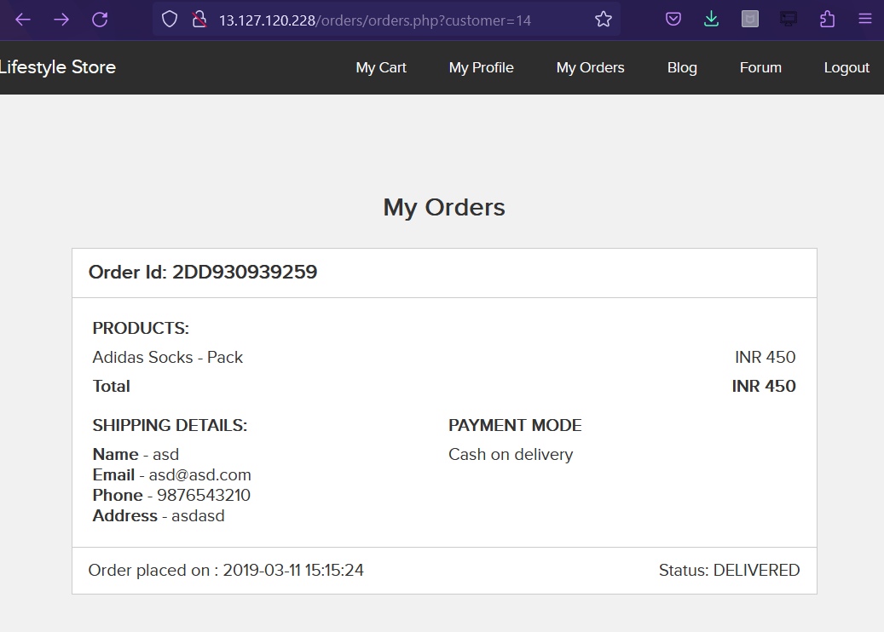
Change the customer number to any random number, and we get the details of the new customer ID.

Slide 40
Business impact: The impact on the company if the vulnerability is exploited.

Slide 41
Business Impact:
This vulnerability can be exploited by malicious hackers to carry out targeted phishing attacks on the users and the information can be sold to the competitors/black-market.
More over, as there is no rate limiting checks, attacker can brute-force the “user_id” for all possible values and get bill information of each and every user of the organization resulting is a massive information leakage.

Slide 42
Recommendations: Take the following recommendations to secure and avoid OTP bypass.

Slide 43
Recommendations:
Make sure user have the access to self data.
Use proper rate limiting checks on the number of request comes from a single user in a small amount of time.
Implement proper authentication and authorization checks to make sure that the user has permission to the data which is being requested.

Slide 44
References:
https://owasp.org/www-chapter-ghana/
https://portswigger.net/web-security/access-control/idor

Slide 45
4. REFLECTED CROSS SITE SCRIPTING (SEVERE)

Slide 46
These parameters are vulnerable to XSS
RELEVANT URL:
http://13.127.120.228/products/details.php?p_id=4
AFFECTED PARAMETERS:
URL (GET)
PAYLOAD:
<script>alert(1)</script>

Slide 47
Other parameters with similar issues.
RELEVANT URL:
http://13.127.120.228/products/details.php?p_id=29
AFFECTED PARAMETERS:
Review box
PAYLOAD:
<script>alert(12)</script>

Slide 48
Observations: Following slides have the details about the vulnerability observed.

Slide 49
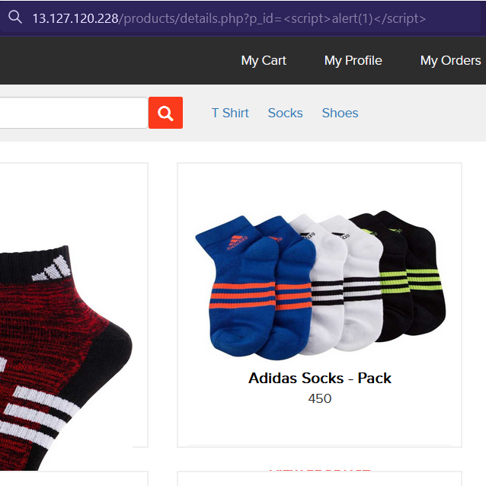
Navigate to the site and login your account.
Go to products and select any product. Now, the URL shows the id of the product you are on, you can replace that with the payload.

Slide 50
Proof of concept: Following slides have the proof and risks of the proposed vulnerability.

Slide 51
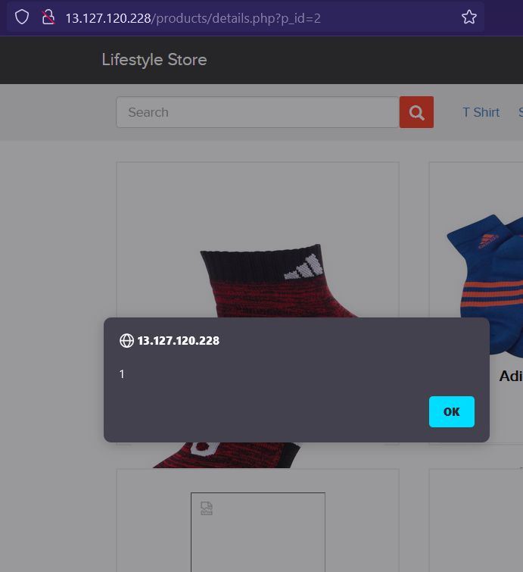
After entering the payload press enter. The page will redirect you to home page but when you click on the same product again it will show the alert you had just input.

Slide 52
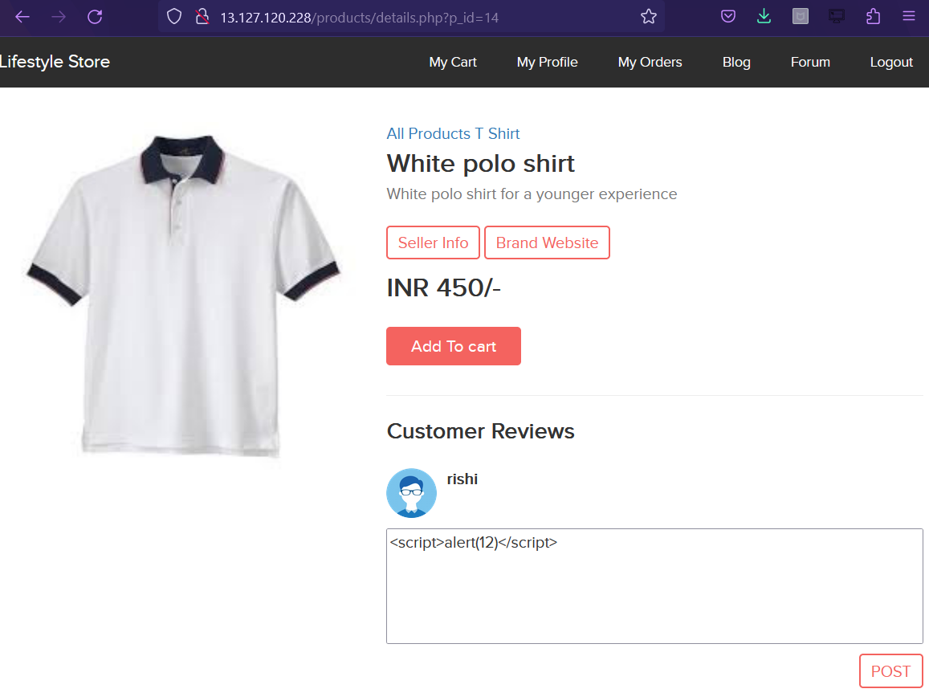
We have a similar issue in the review box.
Inject payload <script>alert(12)

Slide 53
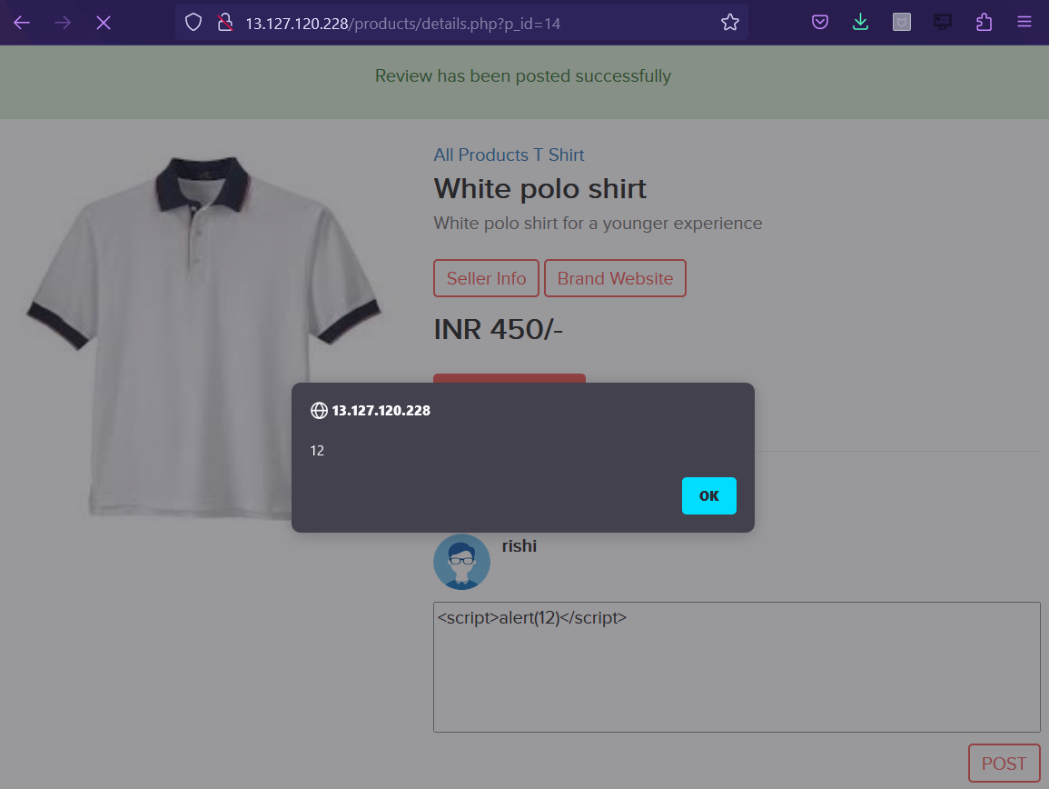
We get the alert by the website.

Slide 54
Business impact: The impact on the company if the vulnerability is exploited.

Slide 55
Business Impact:
As the attacker can inject arbitrary HTML, CSS and Javascript via the URL, they can put any content on the page like phishing pages, and can even host explicit content that could compromise the reputation of the organization.
When the attacker sends the link with the payload to the victim, the victim sees a modified content on the website. As the user trusts the website, user will trust the content as well.

Slide 56
Recommendations: Take the following recommendations to secure and avoid OTP bypass.

Slide 57
Recommendations:
Secure the user input by blocking other inputs which you don’t want.
Encode the HTML/CSS special characters and codes in an encoded form before printing them on the website.

Slide 58
References:
https://owasp.org/www-community/attacks/xss/
https://en.wikipedia.org/wiki/Cross-site_scripting
https://www.w3schools.com/cybersecurity/cybersecurity_web_applications_attacks.php

Slide 59
5. DIRECTORY LISTINGS (SEVERE)

Slide 60
This URL is vulnerable
RELEVANT URL:
http:// 13.127.120.228/robots.txt

Slide 61
Observations: Following slides have the details about the vulnerability observed.

Slide 62
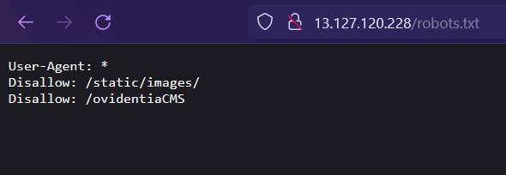
Go to http:// 13.127.120.228/robots.txt
Here, we can see a complete list and directories of the customers, images of products and all the products-page info.
We can also see the administrator directory.
This has a weak password flaw in Ovidentia CMS, which lets an attacker access the administrator panel without much trials.

Slide 63
Proof of concept: Following slides have the proof and risks of the proposed vulnerability.

Slide 64
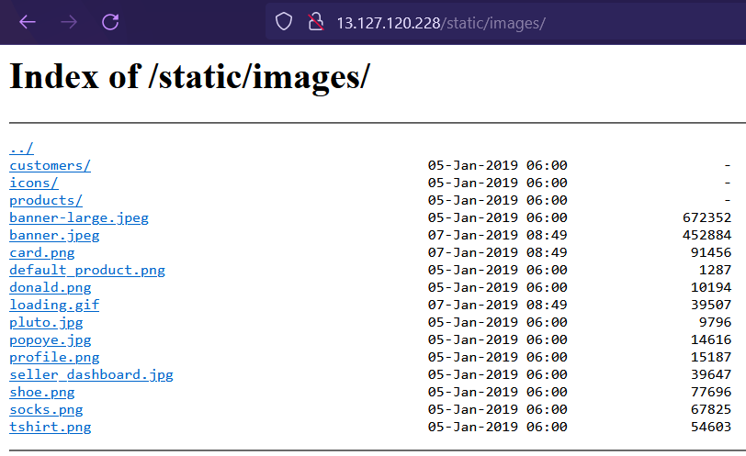
/static/images

Slide 65
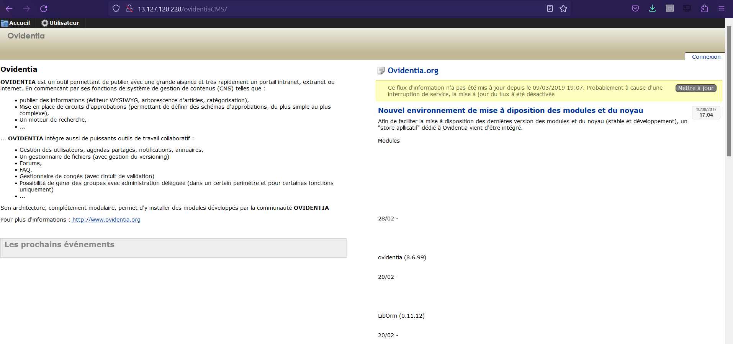
/ovidentiaCMS/

Slide 66
Business impact: The impact on the company if the vulnerability is exploited.

Slide 67
Business Impact:
The hacker can get all the information on the CMS and also get the privileges to tackle with the administrator login credentials and compromise the complete name of the company.
A malicious hacker can take important information from seller point of view and what products every seller is selling at what price and also the information of users.

Slide 68
Recommendations: Take the following recommendations to secure and avoid defacing/data altering.

Slide 69
Recommendations:
Disable all the directory listings.
Include a index.html in all folders with default messages.
Remove all the default passwords and add your own new strong passwords which must have a special character and a number and must be greater or equal to 8 digits for maximum security.

Slide 70
References:
http://www.securitytracker.com/
https://www.w3schools.com/

Slide 71
6. INFORMATION DISCLOSURE (LOW)

Slide 72
This URL is vulnerable
RELEVANT URL:
http://13.127.120.228/server-status

Slide 73
Observations: Following slides have the details about the vulnerability observed.

Slide 74
Go to http:// 13.127.120.228/robots.txt
Complete list and directories of the customer and images of products and all the products page info and also the administrator directory is also shown.
Also this has a weak password flaw in Ovidenta CMS, which lets an attacker access the administrator panel without much trials.

Slide 75
Proof of concept: Following slides have the proof and risks of the proposed vulnerability.

Slide 76
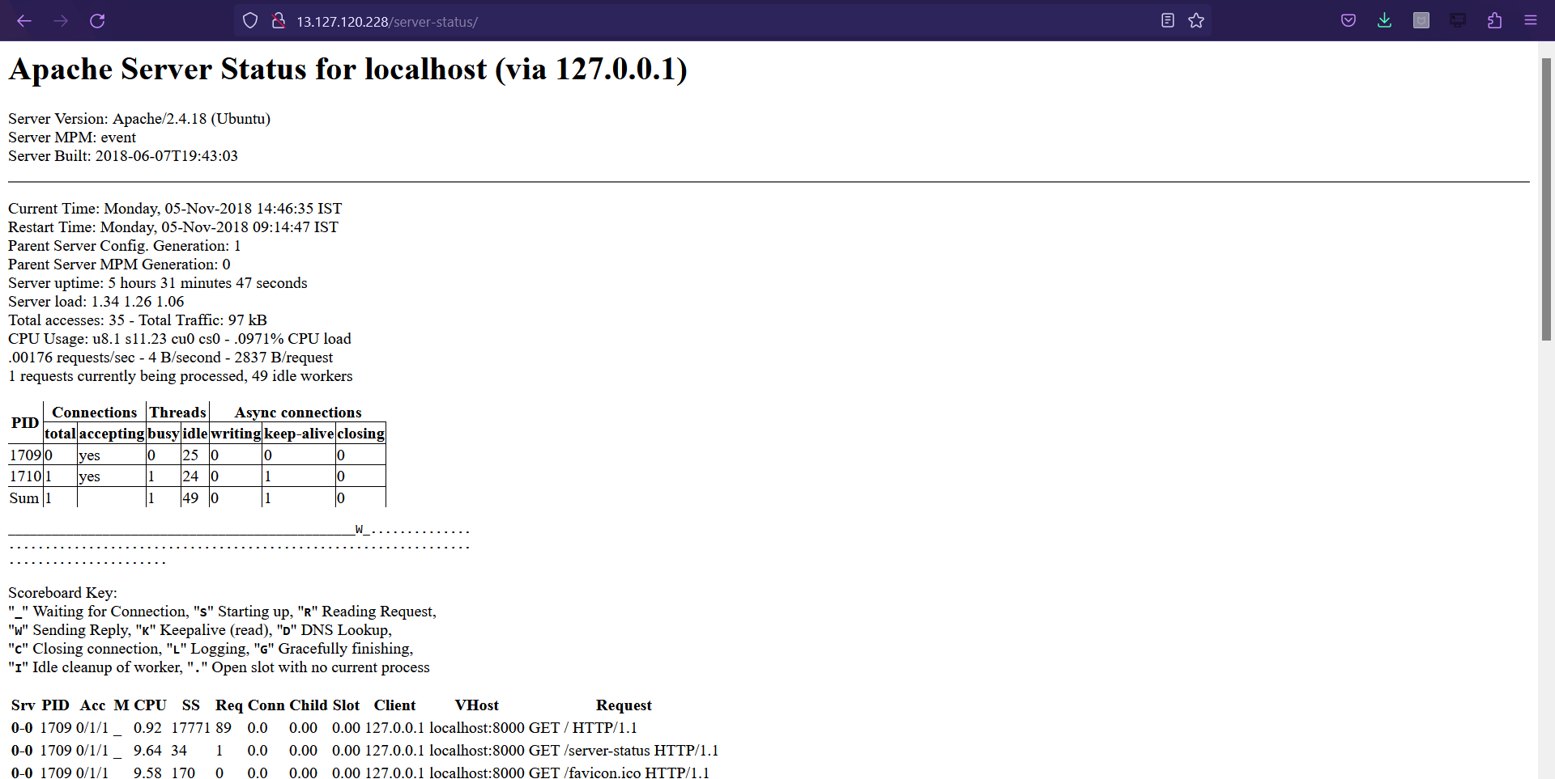
Go to http://13.127.120.228/server-status and the critical server information will be shown as seen below.

Slide 77
/ovidentiaCMS/

Slide 78
Business impact: The impact on the company if the vulnerability is exploited.

Slide 79
Business Impact:
Although this vulnerability does not have a direct impact on the server or the client but a malicious hacker can know things like mapping the server-architecture and map his hacking plan further on what and how to compromise.

Slide 80
Recommendations: Take the following recommendations to secure and avoid defacing/data altering.

Slide 81
Recommendations:
Disable all the directory listings.
Disable the server-status.

Slide 82
7. PERSONALLY IDENTIFIED INFORMATION LEAKAGE (CRITICAL)

Slide 83
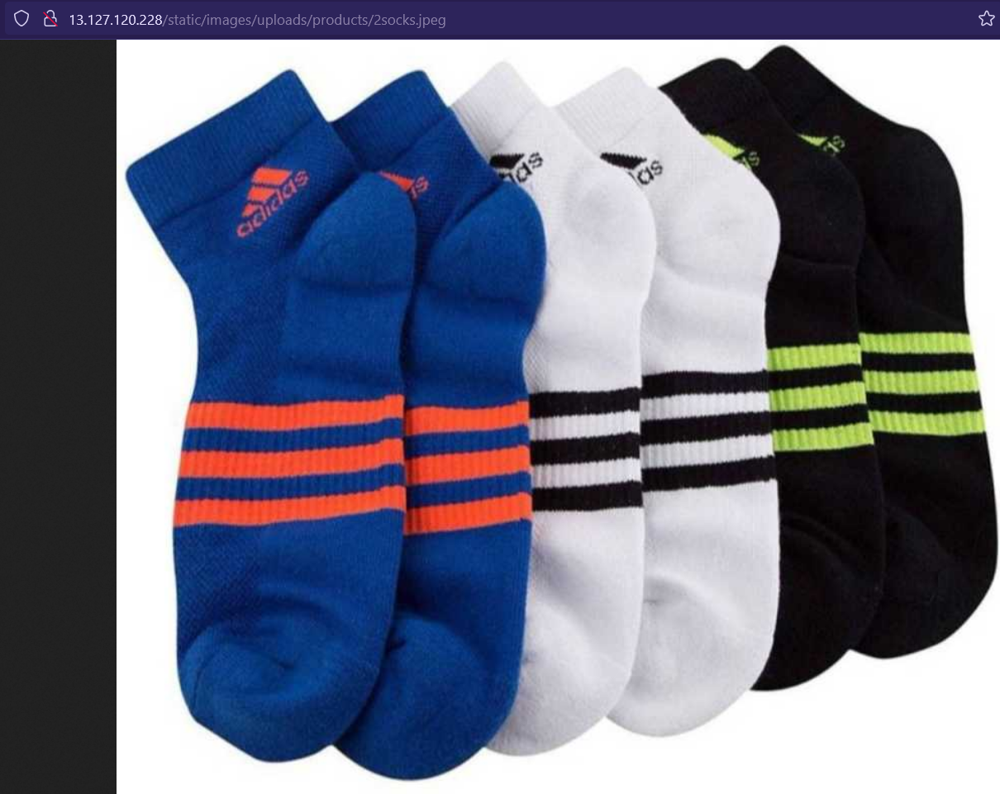
Go to http://13.127.120.228/static/images/uploads/products/2socks.jpeg and drag any drop product image in a new tab, the following page will look like the one shown with the image of the product you chose.

Slide 84
Proof of concept: Following slides have the proof and risks of the proposed vulnerability.

Slide 85
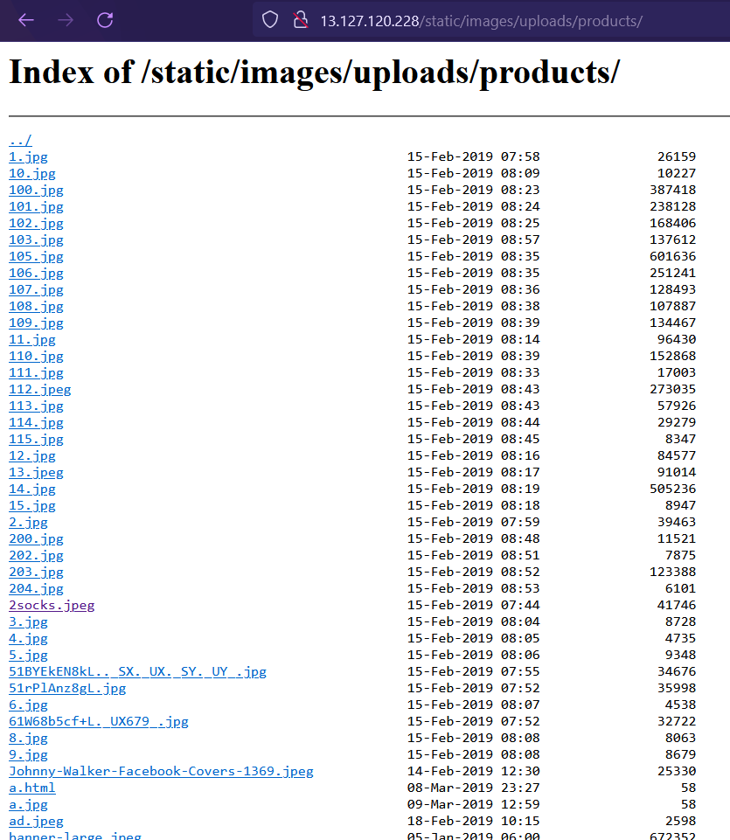
Now, we remove the image name, i.e. “2socks.jpeg” in our case and it enter, the following page with details will be shown.

Slide 86
Business impact: The impact on the company if the vulnerability is exploited.

Slide 87
Business Impact:
A malicious hacker can gain access to the shell application and various other html files which have been shown in the listings.
It can also has a weak-password flaw.
A hacker can get access to the shell and upload his own malicious codes to make the trusted site a hacker room for phishing and tricking users. This will result in defamation of the website.

Slide 88
Recommendations: Take the following recommendations to secure and avoid defacing/data altering.

Slide 89
Recommendations:
Enable 2-factor authentication for sensitive data, and also use stronger passwords of at least 8 characters of different types.
Find all PII stored, and encrypt them with various techniques and also disable all the listings.

Slide 90
References:
https://www.cloudcodes.com/blog/casb-help-organizations-pii-compliance.html
https://www.hackerone.com/resources/reporting

Slide 91
8. SELF REDIRECTION HTML DEVELOPER FLAW (SEVERE)

Slide 92
It redirects to password reset link without authentication.
RELEVANT URL:
http://13.127.120.228/reset_password/customer.php
AFFECTED PARAMETERS:
Password reset

Slide 93
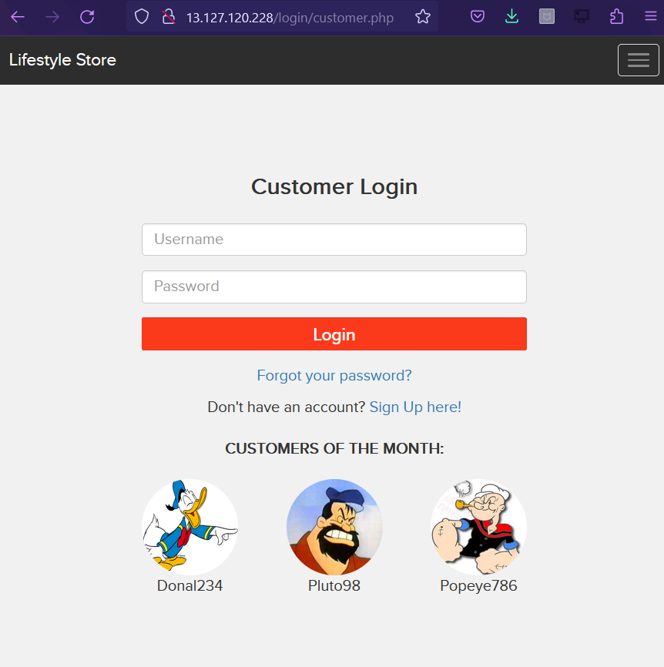
Go to http://13.127.120.228/login/customer.php and you will see names of top customers as shown below, take note of any username.

Slide 94
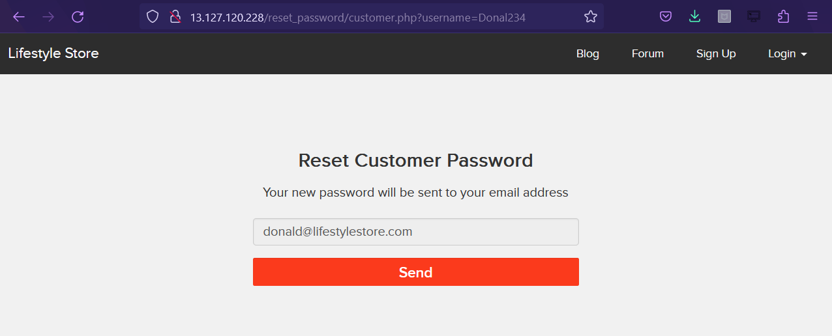
Now, click “forgot your password” and then input the memorized username and click “reset password”. We will see the interface like this, click send.

Slide 95
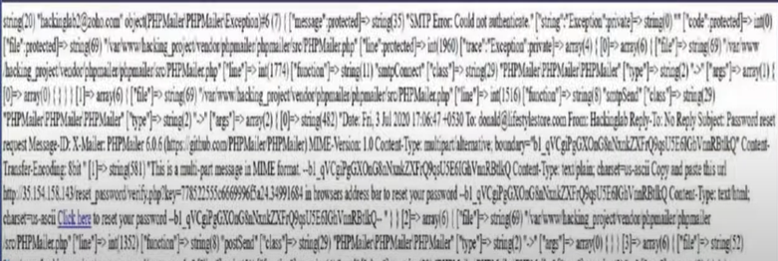
When you click send you are directed to a page like this due to development/authentication error, “click here” button and you will be redirected to change password of the customer.

Slide 96
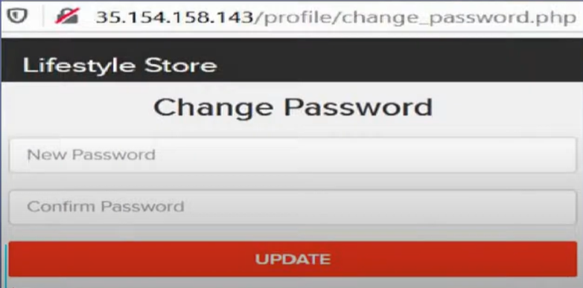
You will be redirected to change password of the customer id, and you will be automatically logged in to that customer’s account even if you don’t change the password, you can change the password for complete takeover of the customer id.

Slide 97
Business impact: The impact on the company if the vulnerability is exploited.

Slide 98
Business Impact:
The impact on the business is high, as a malicious hacker can get access to every user in the website and can login and perform tasks for their benefits and can also make the site vulnerable for security of customers.
This will result in the defamation of the website as the users trust it.

Slide 99
Recommendations: Take the following recommendations to secure and avoid defacing/data altering.

Slide 100
Recommendations:
Better authentication should be provided and re-direction site must be re-checked before action.
There must be a proper authorization access

Slide 101
References:
https://owasp.org/www-project-web-security-testing-guide/latest/4-Web_Application_Security_Testing/04-Authentication_Testing/11-Testing_Multi-Factor_Authentication

Slide 102
9. MULTIPLE VULNERABILITIES FOUND IN BLOG SITE (PII LEAKAGE, TEMPORRARY XSS AND MORE) (SEVERE)

Slide 103
Parameters: URL of the blog site: http://13.127.120.228/wondercms/
RELEVANT URL:
http://13.127.120.228/wondercms/files/b374kmini.php
AFFECTED PARAMETERS:
File upload (POST)
RELEVANT URL:
http://13.127.120.228/wondercms/home
AFFECTED PARAMETERS:
Files (GET)
RELEVANT URL:
http://13.127.120.228/wondercms/files/minisell.php
AFFECTED PARAMETERS:
Shell upload

Slide 104
At the front page of the blog site we can directly find the login option, that says “Click here to login, the password is admin” by clicking on it, it will redirect us to the login page where just by entering ‘admin’ as password one can get access to the admin account of this site.
This is a proper example of server side misconfiguration.

Slide 105
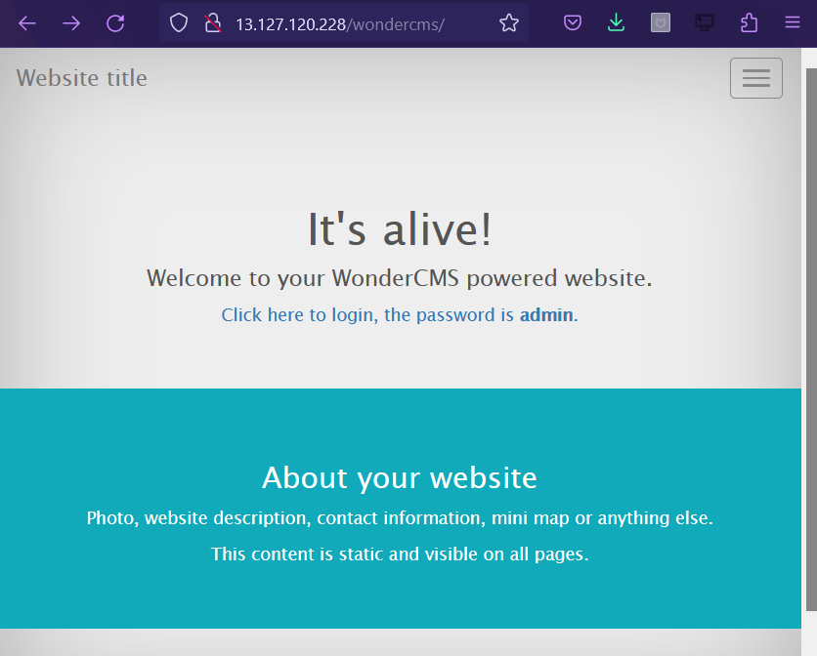
This is how the login page looks like.

Slide 106
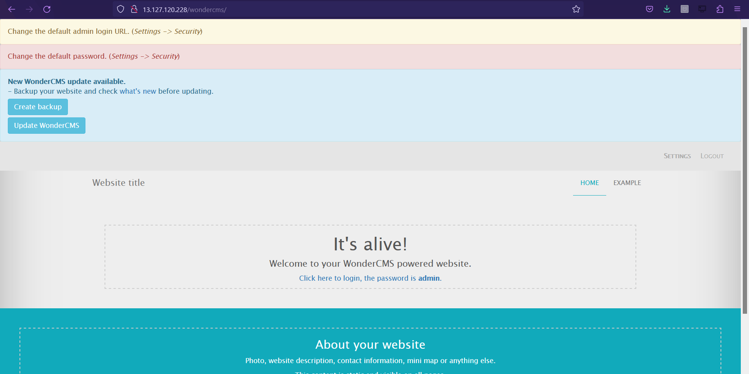
When we log-in as the admin, at the first page of the site we can see some text written “It’s alive!.” If we click on it, the HTML code just starts running and a malicious hacker can easily make changes and can use the page as their phishing portal. This is a classic example of temporary XSS

Slide 107
As we are inside the admin account if we select the settings option and go to ‘files’ menu we can see some files with extension ‘.php’ which can give information about the site and also very much capable of taking over the site.
Here, if we select the ‘/wondercms/files/b374kmini.php’ option, it will redirect us to a page which will give us many crucial information like server IP address, Linux IP address, the server type, the database, shell, the php info, uploads.
The hacker can also mail someone with the admin compromising many factors one of which is the site reputation.

Slide 108
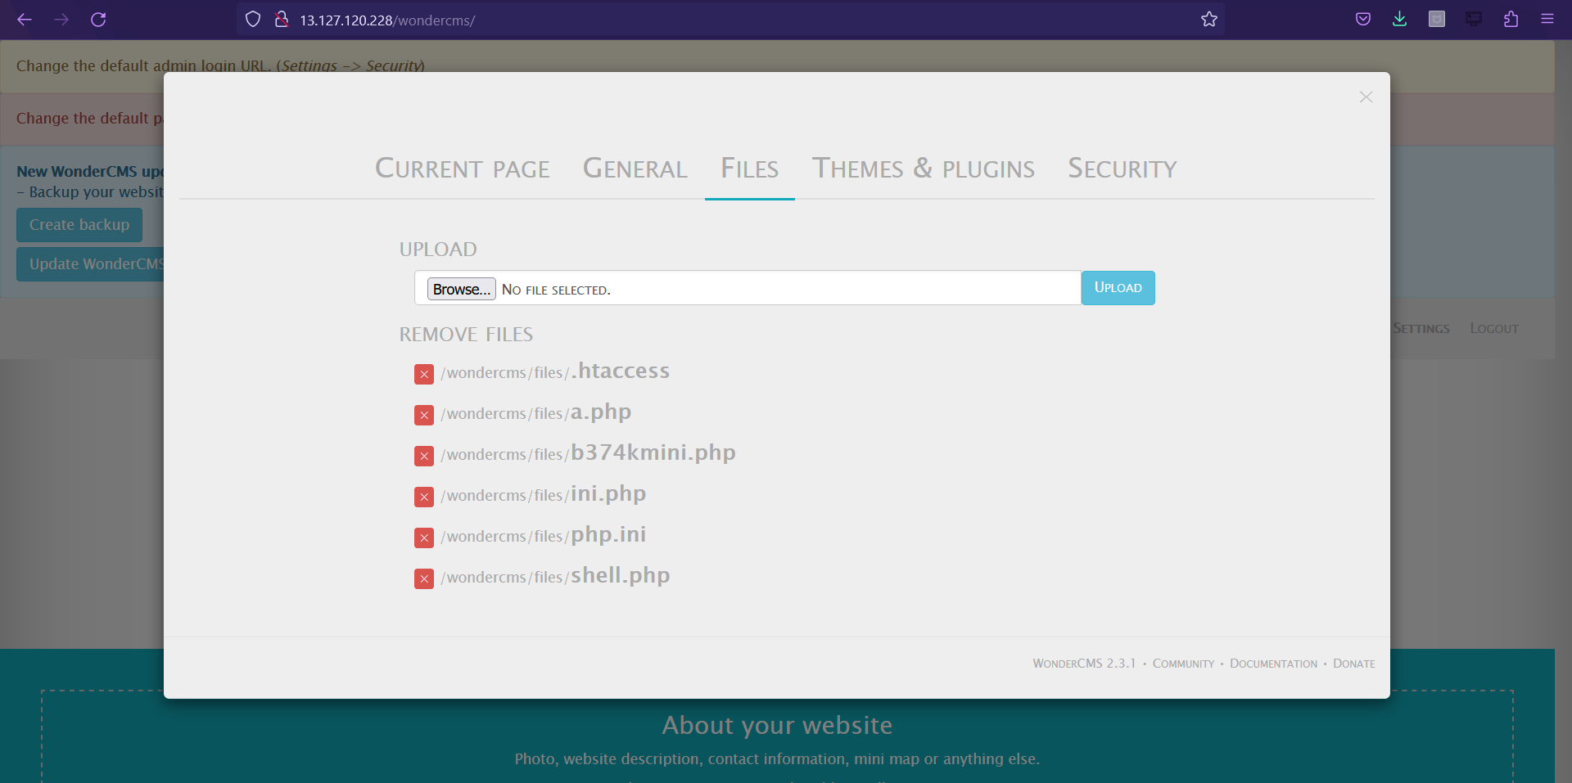

Slide 109
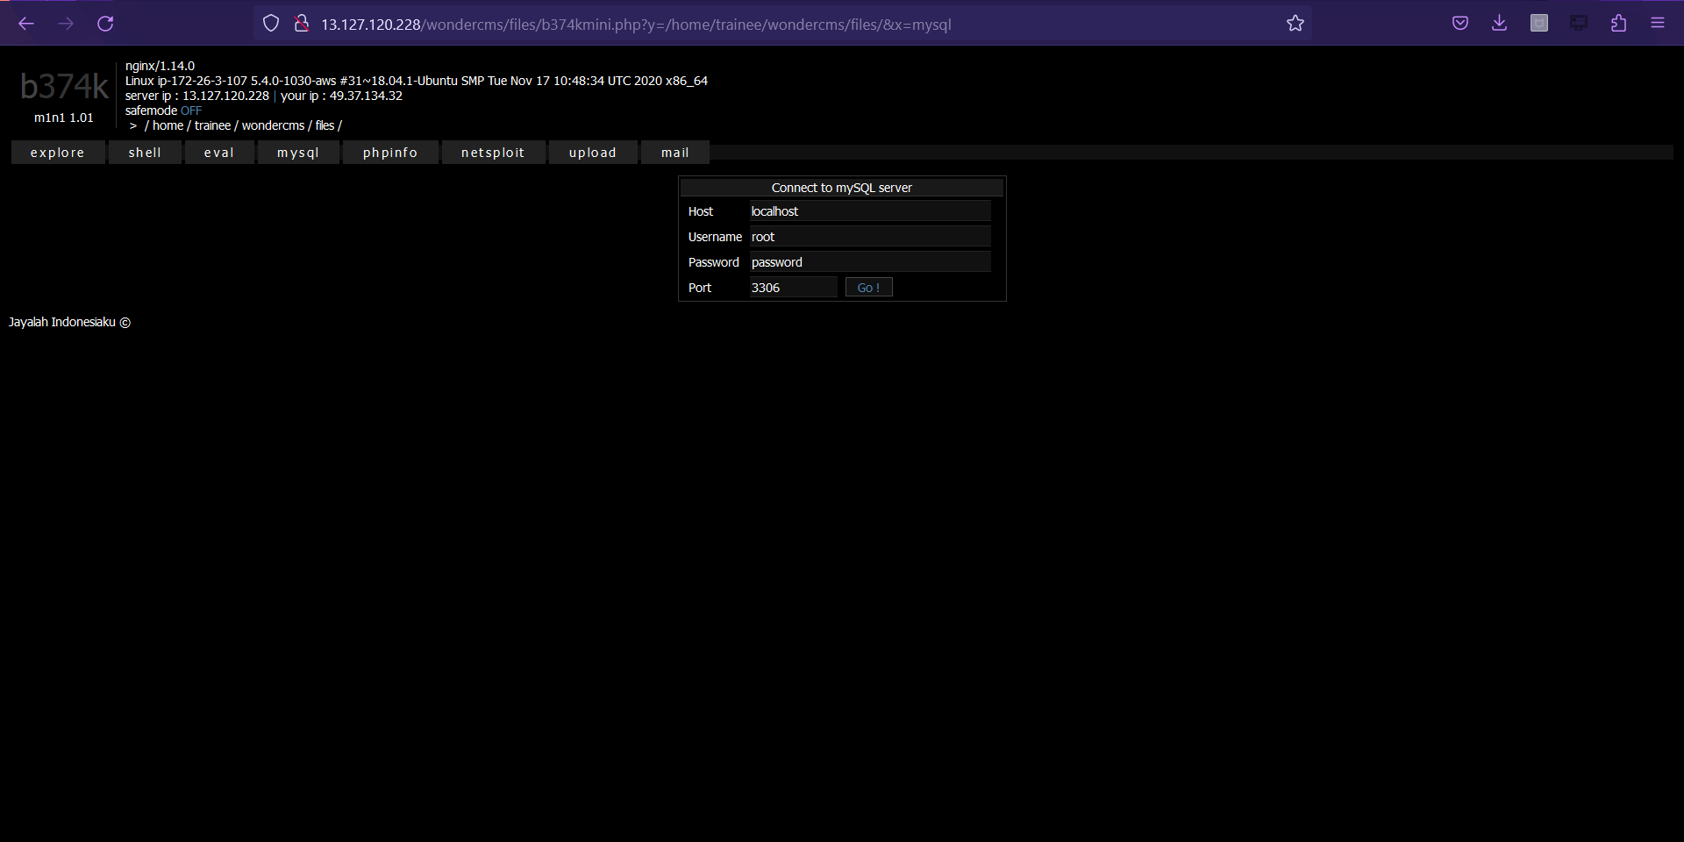

Slide 110
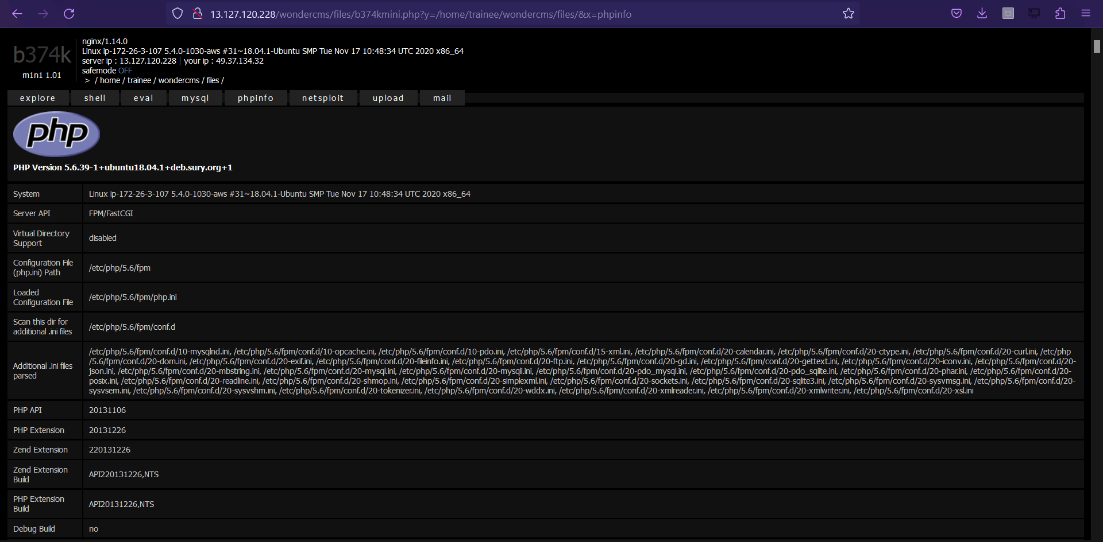

Slide 111
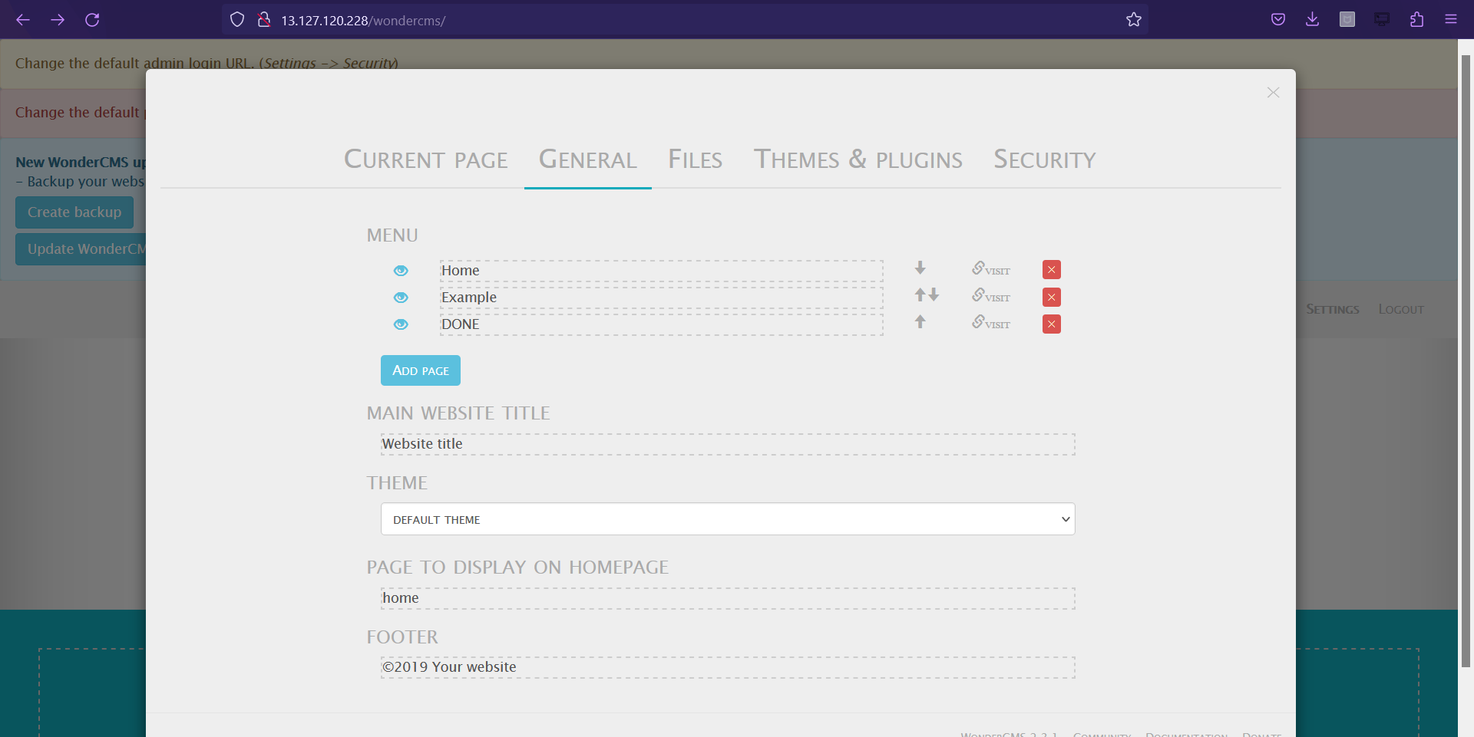
When we are in the admin account and if we go to the general options found in the settings tab. We can see input fields, where a malicious hacker can inject and execute malicious client side scripts which gets permanently stored in the database.

Slide 112
On the same page under settings, click on files here we have a file upload option , which has no limitations on the type of file which can be uploaded.
We can upload files of any extension. Here, when we upload a shell into the site, it will give access to take over the whole website.
This will be a great breakage of the site.

Slide 113
Business impact: The impact on the company if the vulnerability is exploited.

Slide 114
Business Impact:
As the blog site has multiple vulnerabilities such as temporary XSS, server side errors and development flaws the site is extremely vulnerable as a malicious hacker can indulge in the site and can use all the vulnerable components to do phishing and other attacks on user and perform malicious activities.
This will result in defamation of the name of the company, money loss and customers will never trust the website again.

Slide 115
Recommendations: Take the following recommendations to secure and avoid defacing/data altering.

Slide 116
Recommendations:
The website should have proper two factor authentication.
Try to develop the backend more stronger and secure.
Remove all directory listings and add proper sanitization techniques at checks of the website.

Slide 117
References:
https://cwe.mitre.org/data/definitions/548.html
https://www.w3schools.com/

Slide 118
THANK YOU

